Slide 1

PreCanskate and
Canskate
Parent Information
Perth Skating Club
2022-2023 Skating Season

Slide 2
CANSKATE IS THE LEARN TO SKATE PROGRAM WHICH ALL OTHERS ARE MEASURED AGAINST. CanSkate offers the best curriculum in Canada. Our flagship learn-to-skate program has taught millions of Canadians to reach their recreational and competitive goals on the ice.
The CanSkate program is geared to beginners of all ages…children, adults, newcomers to Canada and athletes with a disability (AWAD). Whether you are looking to improve basic skating skills for figure skating, hockey, ringette or speed skating, or wish to skate for recreation, fitness or fun, CanSkate will get you there.
Conducted in a fun, friendly environment, the CanSkate program showcases a comprehensive series of balance, control and agility skills, using a nationally-tested and proven curriculum that supports skater success in developing stronger basic skills on the ice.
Millions of Canadians, including World and Olympic figure skating champions and National Hockey League stars, have taken their first steps on the ice with the CanSkate program. Offered at clubs and skating schools across Canada and delivered by NCCP coaches, CanSkate will help you realize your skating goals.

Slide 3
Who we are
Skate Canada Certified Coaches
  Lise Drummond
  Teri Ann Kirkham
Trained Program Assistants
Alana, Petra, Maddie, Ewan,
Sam, Arianna, Addison, Alison
Volunteer Board of Directors:
President – Amber Corrigan
Treasurer – Desiree Bellevue
Secretary - Krista McFarlane
Registrar – Amber Corrigan
Test Chair – Tammy Crain
Social – Krista McFarlane
Coaches Rep – Lise Drummond

Slide 4
When you first arrive
Please arrive to the main lobby of the Perth Community Centre
Please sign your skater in at the attendance table
PreCanSkate skaters will follow their coloured stars to the appropriate dressing room to put on your skaters and helmet.
CanSkate skaters will find a space in the stands or lobby to put on their skates and helmet.
Your skater can then go to their assigned door and follow the warm up pictures posted. High Knees, Jumping Jacks, Lunges, Squat, Side Bend, and Warrior Pose for a Pre Session warm up.
Your skater will be welcomed on to the ice at the appropriate time by our Program Assistants & Professional Coaches. PreCanSkate #1 - 9:25 - 9:55, PreCanSkate #2 - 9:55 - 10:25, CanSkate - 10:25 - 11:20
Parents are not allowed on the ice at any time, but are required to stay at the rink during the entire CanSkate/PreCanSkate session in case of any injury or bathroom breaks.

Slide 5
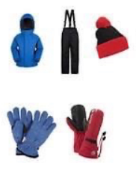
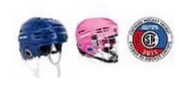

Things you neeD
CSA approved hockey helmet (bike helmets are not approved)
Skates that have been sharpened
Clothing
CSA approved helmet must be worn until the skater has completed the Stage 5 badge – This is a Skate Canada rule - There are NO exemptions from this policy, as helmets are required for insurance purposes. We recommend skaters in the PreCanSkate and CanSkate programs to wear a cage on their helmet to help protect the skaters face and teeth.
Purchasing appropriate and properly fitting skates for the level of your skater is important. Here are some general guidelines:
• Avoid the temptation to buy a larger size for your skater to “grow into.” Skates that are too big will frustrate the skater and hurt their feet.
• Firm ankle support is key. Ankles should never appear to fall over. Take the time to tie your skates correctly to improve your skaters performance and keep your ankles supported. Skates should be laced softly over the toe and front of the boot but snuggly over the ankles.
• Look for good quality leather. Leather boots are preferable to vinyl. Moulded plastic skates are not recommended.
  Warm mittens
  Snowpants or slush pants
  Warm jacket
  Scarves can be a hazard on the ice and should be avoided.
  Excess laces should be tucked or tied up so that they do not drag on the ice.
  Hair should be tied back so your skater can see properly.

Slide 6
How to maintain your equipment
Ensure you fully dry the blades of your skates following each session
Do not store your skates with guards on as this will increase rusting
Ensure you air out skates and dry clothing between sessions
To protect the skate blades, skate guards should be worn in any area that is not protected by rubber mats. Please avoid walking on the cement with your blades
Ensure that your skates are sharpened approx. every 20 hours of skating

Slide 7
Events and Theme days
BEACH DAY
September 24, 2022
HALLOWEEN DAY
October 29, 2022
JERSEY DAY
November 26, 2022
HOLIDAY PAJAMA DAY
December 17, 2022
CANADA DAY in JANUARY
January 21, 2023
VALENTINES DAY - Wear Red & Pink
February 11, 2023
SUPERHERO & PRINCESS DAY
March 11, 2023
Each month our team hosts a theme day where skaters can dress-up
Please ensure your skater continues to wear their properly fitted helmet for these theme days
We also host special events and fundraisers throughout the year that you will be receiving information by email for, please ensure you are updating your calendar with this information

Slide 8
Cancellation days
October 22, 2022
November 12, 2022
December 3, 2022
Christmas Break
December 23, 24, 28, 30, 31
January 28, 2023
February 18, 2023
April 1, 2023
As much as we like to be at the rink with our skaters each week, we have cancellation dates related to other needs of the community and/or our skaters
Please be aware that these cancellations dates were taken into consideration when planning our season

Slide 9
Volunteers
Our volunteers are parents of skaters just like you
If you are open to offering your time or expertise throughout the season, please touch base with one of our amazing executive members to ask how you can help!

Slide 10
Program Assistants
Our program assistants are skaters you see helping our younger athletes with the Blue T Shirts
These program assistants have received special training throughout the season to support our PreCanSkate and CanSkate programs

Slide 11
Review of session format
The PreCanSkate and CanSkate program is organized into seven progressive stages of learning from PreCanSkate to Stage 6. The fast-paced program introduces skaters to the ABC’s of skating that are FUNdamental skills for all ice sports. Agility: concentrating on turning and jumping skills. Balance: concentrating on forward skills, pushing techniques and edges. Control: concentrating on backwards skills, stopping and speed elements.
The CanSkate session starts with a warm-up led by our program assistants
Skaters will rotate from station to station with continuous movement and with the use of the full ice surface, the fast track, group learning stations, and circuits, we will challenge all skaters to push their learning and further their progress by exposing them to more skills.
Skaters will grouped based on skill and badge level as set out by our program guidelines. Grouping of the skaters is an ongoing process as skaters’ progress at their own rate. Skaters may be shuffled from time to time to ensure they are being challenged and exposed to new skills while continuing to practice and develop skills.
Our goal is to have your child moving for 90% of their session
Sessions end with a group activity and cool-down
All our sessions have the main goal of learning while having fun!

Slide 12
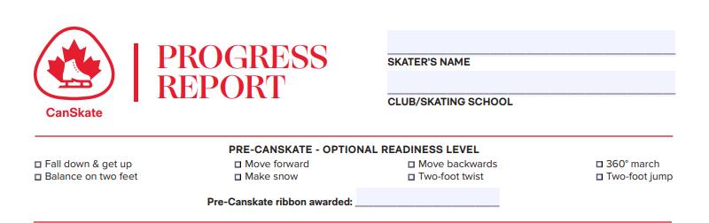
Reading report cards
–
PreCanskate
Report cards and badge marking happen throughout the skating season
As skaters complete badge levels your skater will receive their badge and continue working on the next level
For our PreCanSkate skaters, completion of the first badge means moving to the CanSkate session and this will be discussed with the parents as the completion happens

Slide 13
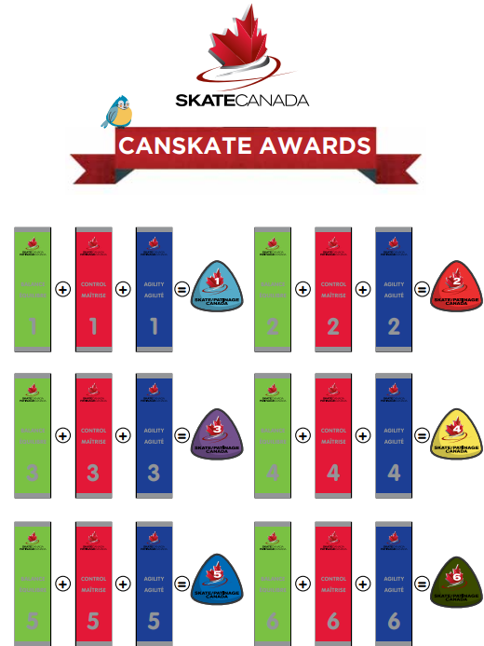
report cards – Canskate

Slide 14
How to reach us
Communication is very important to the success of our programs so please do not hesitate to ask questions and give us your feedback at Perthfsc@gmail.com For updates and more information please visit our website - https://perthfsc.uplifterinc.com/ or join us on our Facebook page at Perth Figure Skating Club. Thank you for participating in our Program. We hope you and your skater(s) have a wonderful skating season and one that promotes an interest in life long participation in skating. Happy Skating!!

